Slide 1
Final Engagement
Attack, Defense & Analysis of a Vulnerable Network

Slide 2
Table of Contents
This document contains the following resources:
Network Topology & Critical Vulnerabilities
Traffic Profile
Normal Activity
Malicious Activity

Slide 3
Network Topology
& Critical Vulnerabilities
‹#›

Slide 4
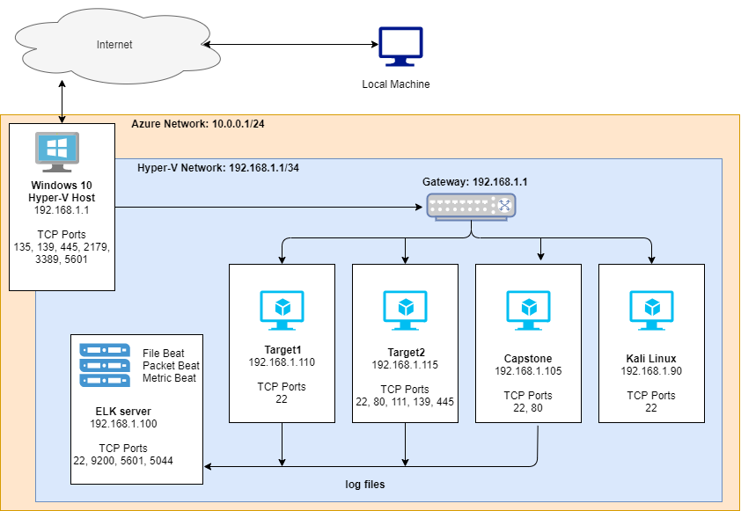
Network Topology
Network Address Range: 192.168.1.0/24
Netmask: 255.255.255.0
Gateway: 192.168.1.1
Machines
IPv4: 192.168.1.105
OS: Ubuntu 18.04.1 LTS
Hostname: CAPSTONE
IPv4: 192.168.1.100
OS: Ubuntu 18.04.4 LTS
Hostname: ELK
IPv4: 192.168.1.110
OS: Linux 3.2-4.9
Hostname: TARGET 1
IPv4: 192.168.1.115
OS: Linux 3.2-4.9
Hostname: TARGET 2

Slide 5
Traffic Profile
‹#›

Slide 6
Traffic Profile
Our analysis identified the following characteristics of the traffic on the network:
Feature | Value | Description
Top Talkers (IP Addresses) | 172.16.4.205, 185.243.115.84, 166.62.111.64 | Machines that sent the most traffic.
Most Common Protocols | VSS Monitoring Ethernet trailer, HTTP, TLS | Three most common protocols on the network.
# of Unique IP Addresses | 877 | Count of observed IP addresses.
Subnets | 24-bit blocks | Observed subnet ranges.
# of Malware Species | Trojan named june11.dll | Number of malware binaries identified in traffic.
Notes:
You may have more than 2 subnets.

Slide 7
Behavioral Analysis
Purpose of Traffic on the Network
Users were observed engaging in the following kinds of activity.
“Normal” Activity
Browsing websites and wordpress traffic.
File transfers such as scripts and images.
API activity for different browser-site interactions.
Suspicious Activity
Torrent file download. Betty_Boop_Rhythm_on_the_Reservation.avi.torrent
Trojan down. (june11.dll)

Slide 8
Normal Activity
‹#›

Slide 9
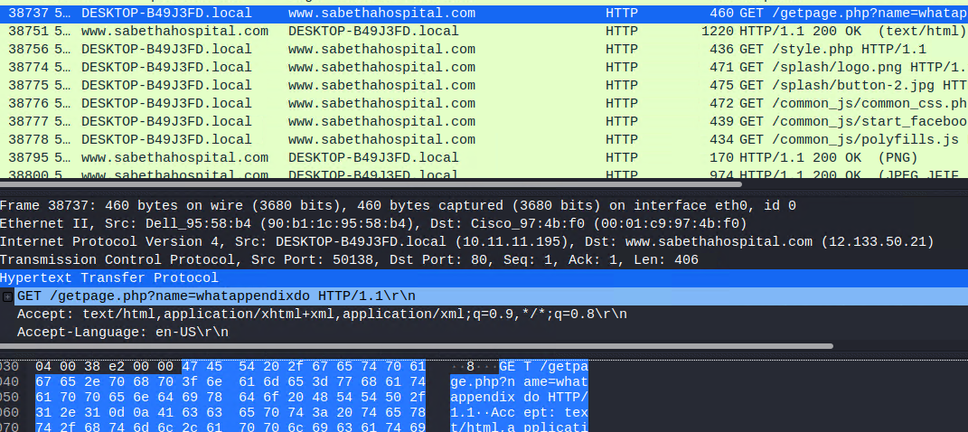
Browsing Online
Summarize the following:
What kind of traffic did you observe? Which protocol(s)?
TCP and HTTP traffic
What, specifically, was the user doing? Which site were they browsing? Etc.
User appears to be learning to hack iphones. Need to determine if this is appropriate, Other websites include hospital and medical advisory pages.
www.iphonehacks.com
mysocalledchaos.com
sabethahospital.com

Slide 10
Malicious Activity
‹#›

Slide 11
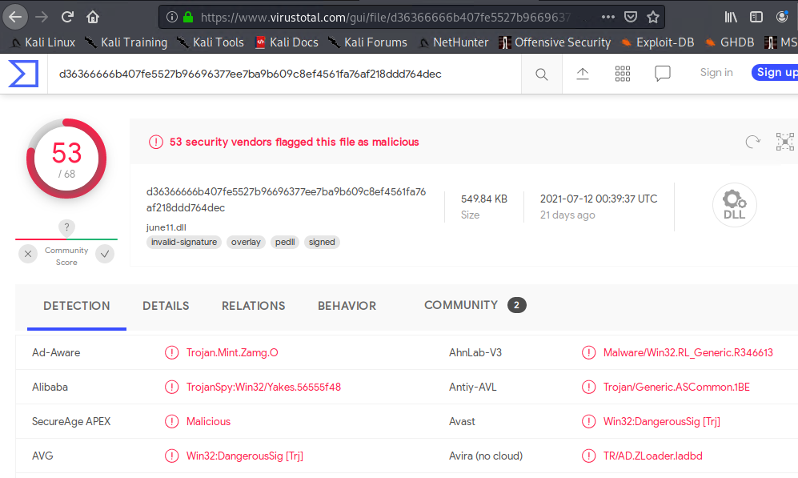
Malicious File Download (Trojan)
Summarize the following:
What kind of traffic did you observe? Which protocol(s)?
HTTP
What, specifically, was the user doing? Which site were they browsing? Etc.
User downloaded a trojan from the following site: http://205.185.125.104/files/june11.dll
Include a description of any interesting files.
june11.dll

Slide 12
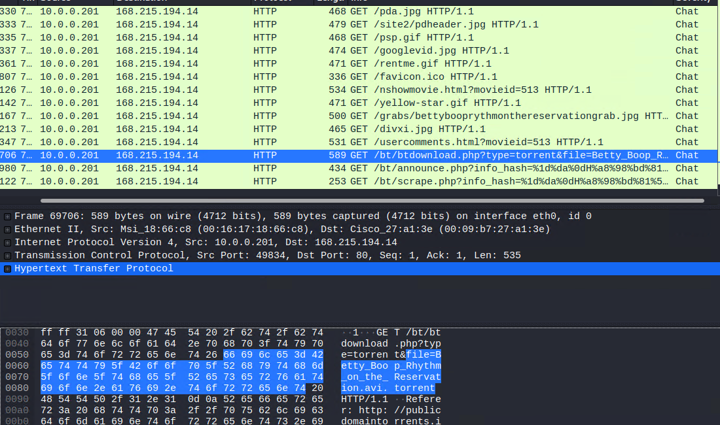
Downloading Torrent Files
Summarize the following:
What kind of traffic did you observe? Which protocol(s)?
HTTP traffic.
What, specifically, was the user doing? Which site were they browsing? Etc.
The user was browsing and downloaded a .torrent file from publicdomaintorrents.com
Include a description of any interesting files.
Betty_Boop_Rhythm_on_the_Reservation.avi.torrent

Slide 13
The End
‹#›

